Slide 1
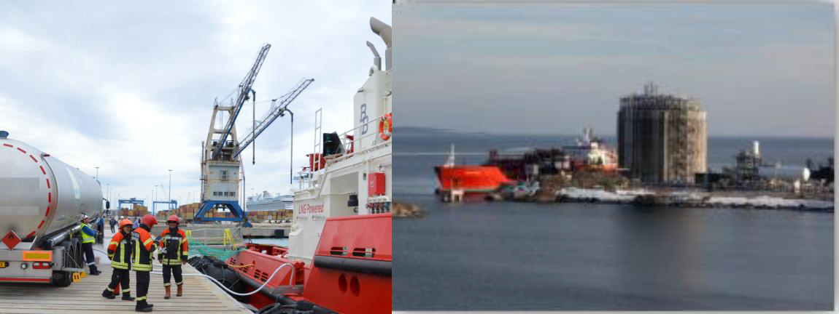
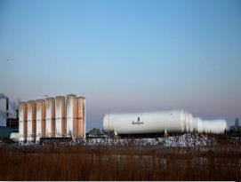
LNG as an ecological fuel: from idea to implementation
Gazprom export LLC
Igor Maynitskiy
Head of LNG Exports Division
March 2016

Slide 2
Commercial and regulatory drivers are responsible for market growth
Lower fuel costs compared to Diesel and tax reductions in most European countries enable a realistic payback period of the higher investments for LNG client applications (e.g. ships, trucks, buses)
Reduced Emissions (i.e. CO2, NoX, SoX) are attractive for green company image campaigns (intangible value but increasing importance for market acceptance of clients = better competition position with more sales will lead to tangible value)
Diversification of Diesel fuel dependency for fleet owners and differentiation of vehicle manufacturer
Commercial
Increasing interest in LNG as a fuel for ships, trucks and buses
EU 2030 targets: -30% Greenhouse gas emissions compared to 2005
TEN-T: EU transport infrastructure policy aims to close gaps between Member
States' transport networks, remove bottlenecks and overcome technical barriers
SECA: Sulphur Emission Control Areas within the Baltic Sea and North Sea set new sulphur emission limits (only fuels with >0.1% sulphur mass fraction)
EU directive for alternative fuel infrastructure: MS are asked to identify an appropriate number of refueling points until 2025: approx. 400km, undefined number for maritime and inland ports until 2030
Regulatory
1

Slide 3
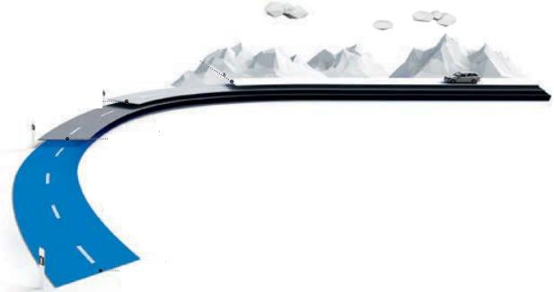
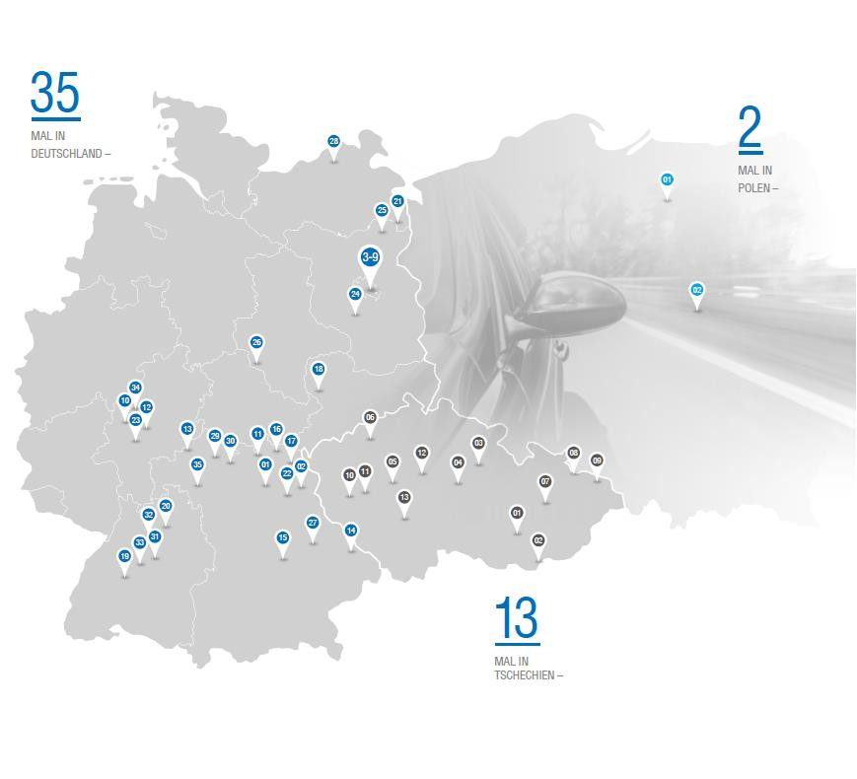
Development of project opportunities: Gazprom Group‘S position today
Development of LNG production and
retail infrastructure in progress
European Gazprom companies extending CNG presence in Germany, Poland and the Czech Republic from 49 to > 60 CNG stations by mid of 2016
Gazprom export & European Gazprom companies together with partners developing LNG for European road and maritime transport
Active communication, education and stakeholder management at national, European and international level
How far will EUR 10.00 of the following fuels take you?*
100 km /petrol
166 km /LPG
169 km /diesel
201 km /CNG
Gazprom Group CNG/LNG stations in Europe
35
2
14
2
* Erdgas mobil data for an Opel Zafira Tourer at German CNG prices and average fuel consumption for engine with 130-150 HP in July 2015

Slide 4
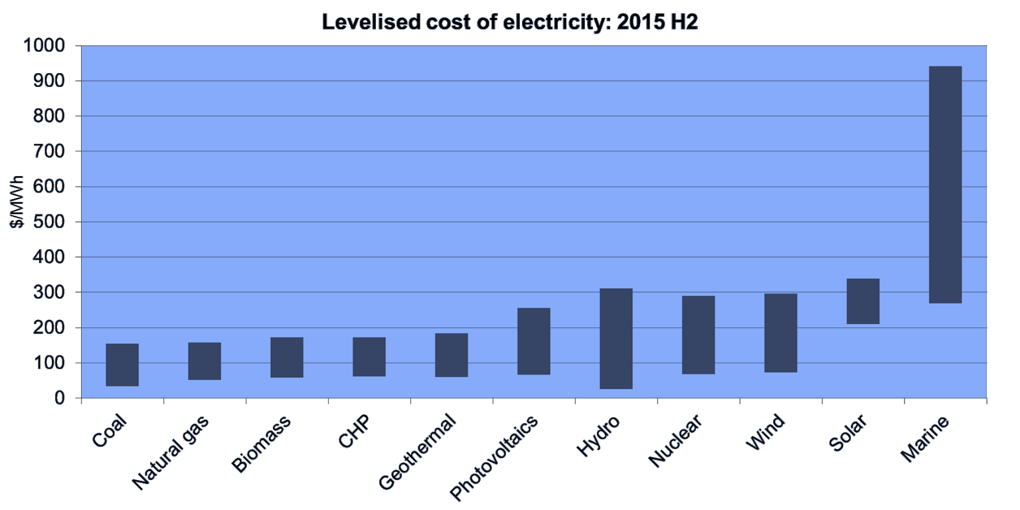
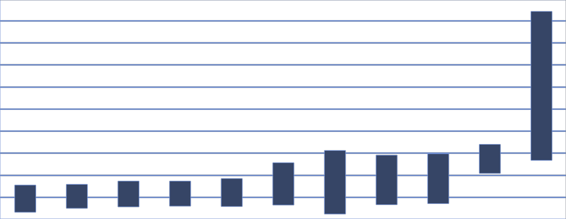
Сosts of different types of energy
Source: Bloomberg New Energy Finance

Slide 5

















LNG projects portfolio
Finland
CS Portovaja 2018
1-2 mtpa
660
ktpa
Vysotsk 2018
Peterhof 11 ktpa
Estonia
Baltic LNG
10 mtpa
Kingisepp 11 ktpa
Latvia
23
ktpa
Pskov 3Q 2016
Poland
23
ktpa
Lithuania
design stage construction operating
Bunkering
Off-grid customers

Slide 6


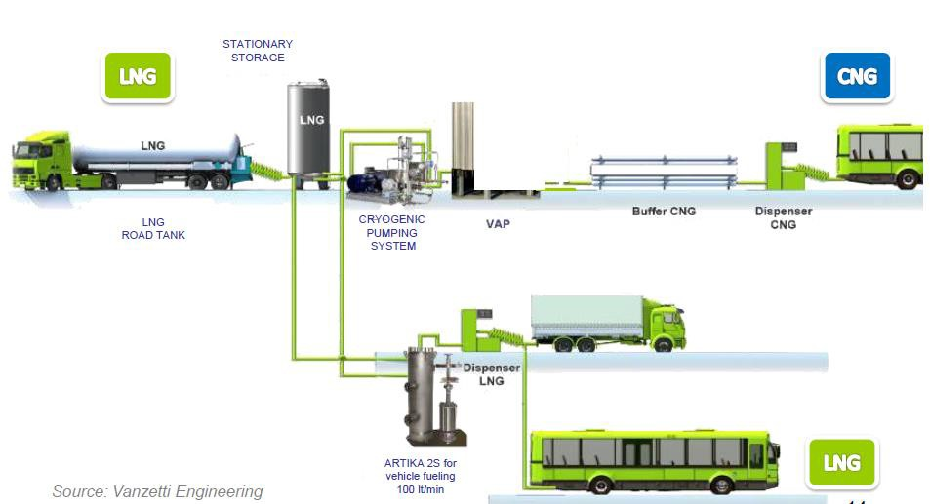
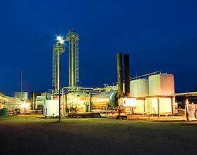
Operating principles of LNG/LCNG filling stations
LNG production /
Terminal
Distribution
Refuelling
End use

Slide 7
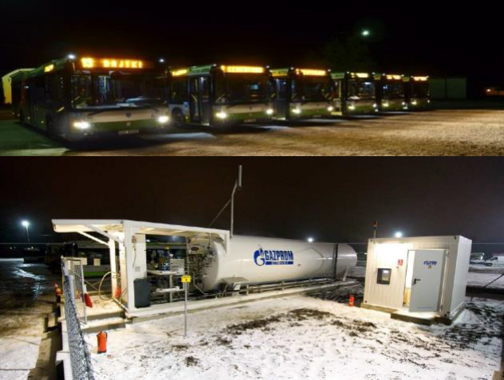
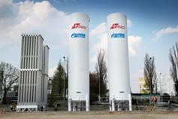
Launch OF LNG city buses in the Polish Cities OF Olsztyn and Warsaw
October 2013: launch of Europe’s first LNG city buses in the Polish city of Olsztyn
11 x 12m solo LNG buses up to later 50 LNG buses by 2016/2017
Operations 7 days per week / 65.000 km per bus p.a.
Since Oct 2013: refueling by GPG’s mobile LNG station
Implementation and operation of fixed skidded station in Q4/2014
January 2015: launch of 35 LNG city buses in Warsaw and construction of the first LCNG station in Poland
35 x 18m articulated LNG buses up to later 200 LNG buses by
2016/2017 as well as LCNG-add-on for 30 CNG buses
Operations 7 days per week / 80.000 km per bus p.a.
From Q1/2015: refueling by mobile LNG station
Implementation of fixed station in Q3/2015

Slide 8
LNG lessons learned (Market)
Main interest for potential LNG clients (buses and trucks) are cheaper but also more projectable TCO costs, ecology comes second
LNG pricing with diesel indexation reduces client risk, but increases supplier risk
1
Financing of LNG vehicles as bottleneck for LNG projects due to a low/non-existing risk appetite of banks with respect to uncertainties about resale values
Differences in national and local permitting and operational requirements (e.g. safety standards) create challenges for speedy project implementation and standardization
Fuel savings are not the only decision criteria for fleet owners; noise (city traffic at night/morning hours) and operational improvements like faster refueling or no fuel losses/theft become more important
Reliability and profitability of LNG station projects strongly depends on the availability of small scale LNG volumes (e.g. reasonable distances from LNG source, qualified logistics)
Currently low choice of LNG vehicle models with sufficient horsepower, which results in lower competition (higher price mark ups and inferior after sales service)
Concepts for 2nd hand market for LNG vehicles needed
2
3
Create standards by creating facts / need for EU harmonization
4
Listen to what the client’s real concerns are
5
Additional ssLNG sources
in Europe are needed
6
Additional LNG models & economies of scale crucial

Slide 9
LNG lessons learned (Technical)
1
Different LNG qualities and temperatures (cold/warm LNG) are challenging for the station operation
Few sources of LNG / station to be able to handle different qualities
2
Boil-off is unavoidable even during normal operation (especially heat intake from vehicles and vacuum insulated pipelines if very long)
Boil-off handling to be foreseen from beginning
/ sufficient throughput
3
Mobile stations enable fast realization of LNG projects and are required as backup for the start-up phase
Availability of mobile station is crucial
4
Combination of LNG and CNG demand increases project profitability and
stabilize operations (boil-off management)
Add LCNG from the beginning if demand can be generated
LNG clients (buses and trucks) are very sensitive to outages/failures of the LNG station (no refueling alternatives, delicate load, time pressure, etc.)
5
Redundancy of key
components is crucial
Base load demand and conservative expectations on fleet size growth and additional clients influence sizing of station
Modular approach if possible / mobile refuelling can be good option for pilot phase
6

Slide 10
Some practical remarks to the market situation for the Natural gas for transport business
Currently low oil/Diesel pricing delays investment decision and challenge a change towards LNG
But,…
  very volatile oil/Diesel pricing have recovered and are assumed to increase again within next years
  investors keep investing into refueling stations (subsidies with deadlines, lead time)
  investment cost “Premium“ for NGV and refueling stations (especially for LNG) is expected to decrease
Gas for transport infrastructure is slightly growing but still limited across Europe (especially for LNG)
But,…
  CNG station network development extended by LCNG station (for off-grid areas/customers)
  Increasing SSLNG applications at LNG import terminals enlarges LNG for transport availability.
  EU and regional programs for clean mobility are in place (e.g. Clean Package for Transport, Ten-T, LNG Blue Corridors, …) and facilitate the infrastructure development by financial support, regulation and standardization
Even with an increased awareness for NGV prejudices and wrong information block the change
But,…
  New, improved and additional NGV models become available on the European market
  Awareness campaigns for transparent price information for alternative fuels started the political decision process

Slide 11






Key messages to remember
Natural gas is clean, abundant and affordable
Vehicles and refuelling technology are proven, safe and reliable
Market potential for natural gas as fuel for road transport and marine fuel is significant
CNG and LNG are complimentary fuels covering almost all transport sectors
As market is still developing, policy measures are required to motivate investors and end users to switch to natural
gas as fuel
Gazprom is ready to contribute to market development by providing reliable supplies of natural gas
10

Slide 12
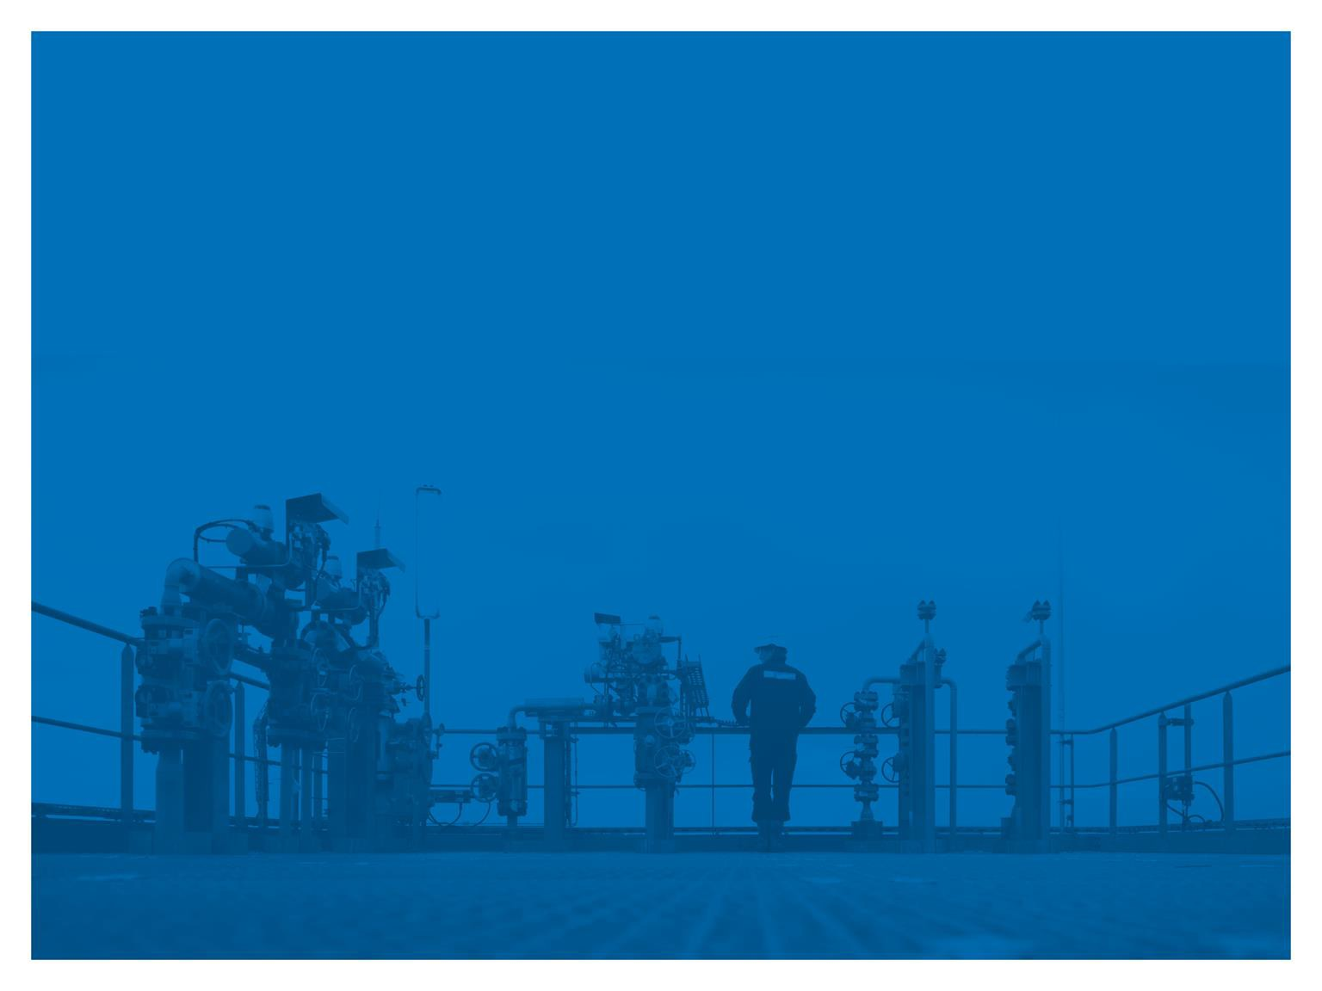

Thank you for attention!
Gazprom export LLC Maynitskiy Igor
Head of LNG Exports Division
Ostrovskogo Sq. 2a, Letter “A” Saint-Petersburg, 191023, Russia
Tel. +7-812-646-16-21
Mail i.maynitskiy@gazpromexport.com Web www.gazpromexport.com
11

